Slide 1


Design and Development of Smart Switching System for Controlling Home Appliances

Slide 2
Contents
INTRODUCTION
OBJECTIVES
BLOCK DIAGRAM
REQUIRED COMPONENTS
OVERVIEW OF 89C52
OVERVIEW OF GSM 900
DTMF DECODER
DIAC & TRIAC
CIRCUIT DIAGRAM
STEPS OF OPERATION
HARDWARE
APPLICATIONS
CONCLUSION
REFERENCES

Slide 3
Introduction
This project will make your Home a digital system and will give the digital features. In this project, one can control, monitor and remotely access the home appliances and turn them on/off through a daily and most often used device which is our mobile phone and you can also check the status whether they are switched on/off. The old traditional switch board will be replaced by a digital board. It will also help one to keep away from electric shock.

Slide 4
Objectives
The main objectives of this project are to –
Control home appliances using cellular phone.
Become Independent of Location.
Know the current status of home appliances.

Slide 5
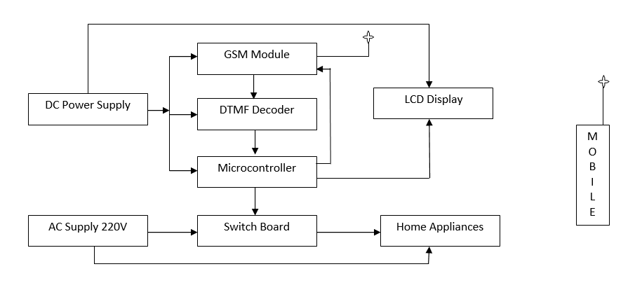
Block Diagram

Slide 6
Required Components
Microcontroller
GSM Module
DTMF Decoder
DIAC
TRIAC
And Others (Resistors, Capacitors, Crystals)

Slide 7
A Brief Descriptions of the Components

Slide 8
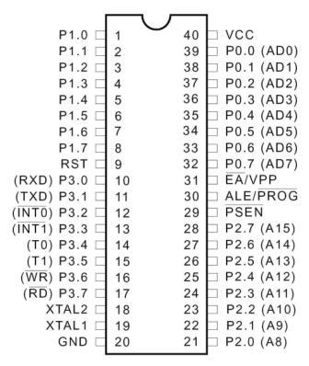
Microcontroller
4K Bytes of In-System
Reprogrammable Flash
Memory – Endurance: 1,000
Write/Erase Cycles
Crystal: 0 Hz to 24 MHz
128 byte of RAM
32 Programmable I/O Lines
Two 16-bit Timer/Counters
Six Interrupt Sources
Programmable Serial Channel
Low-power Idle and
Power-down Modes

Slide 9
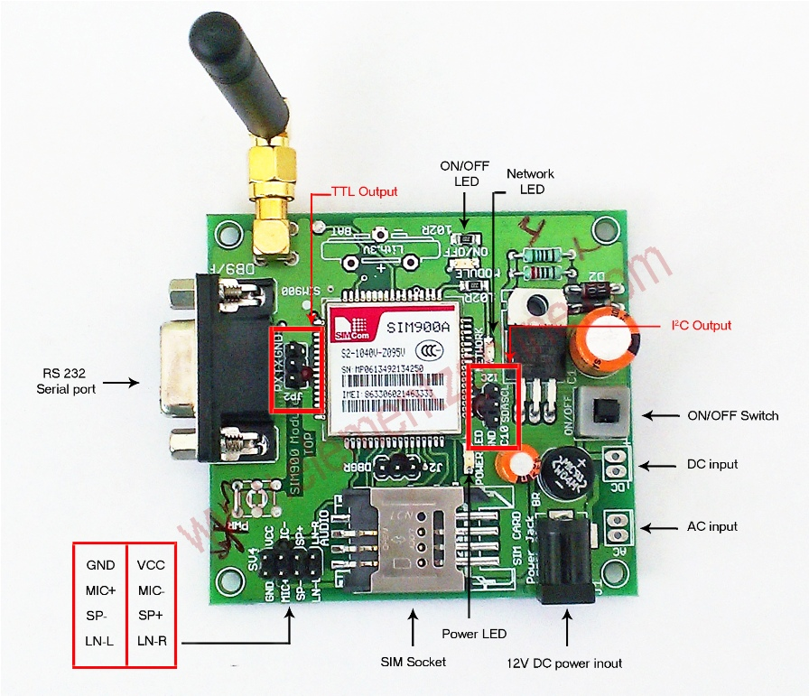
GSM SIM900

Slide 10
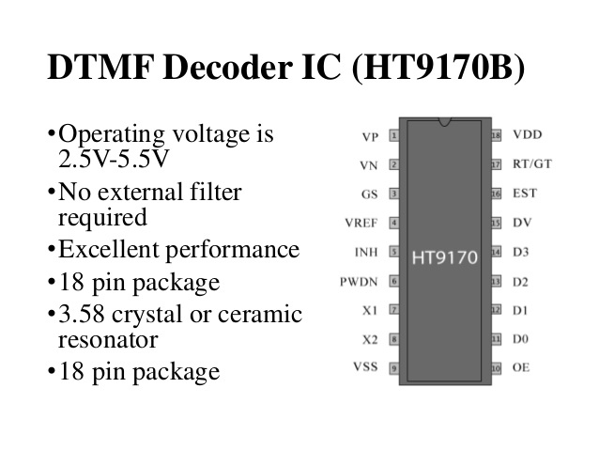
DTMF Decoder
O/P

Slide 11
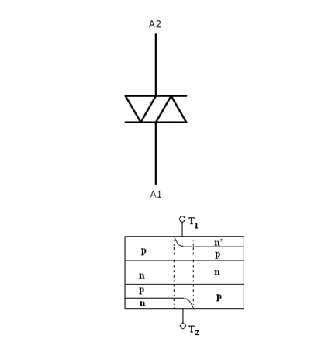
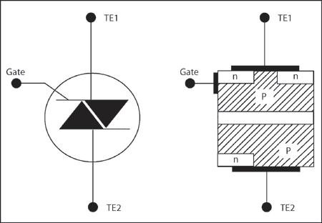
DIAC and TRIAC
This is a bidirectional switching diode used mainly in firing TRIACS in AC control circuits
Unlike a Transistor but without any gate or base terminal.
TRIAC is similar to DIAC but it has a control connection which is the gate terminal.
TRIAC helps to control AC voltage between zero to full power.

Slide 12
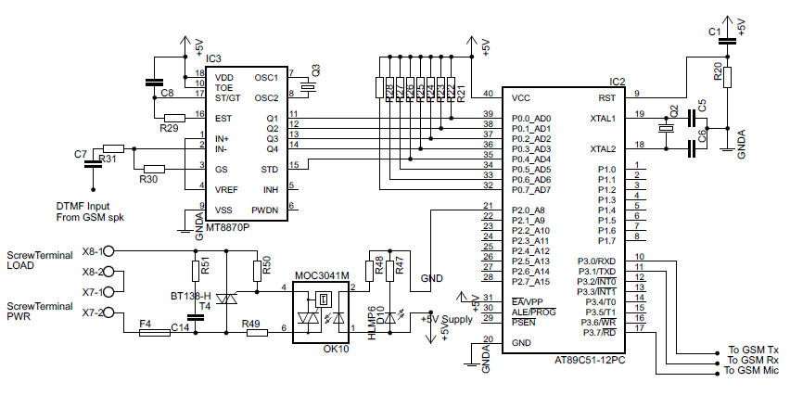
Circuit Diagram

Slide 13
Steps of Operation
Make a call to the system’s number (generally it is a phone number).
Wait for two Rings and the call will be automatically received by the system.
Chose the appropriate key for a particular appliance to make it turned on/off
Press the status key to know the current status of the appliance.

Slide 14
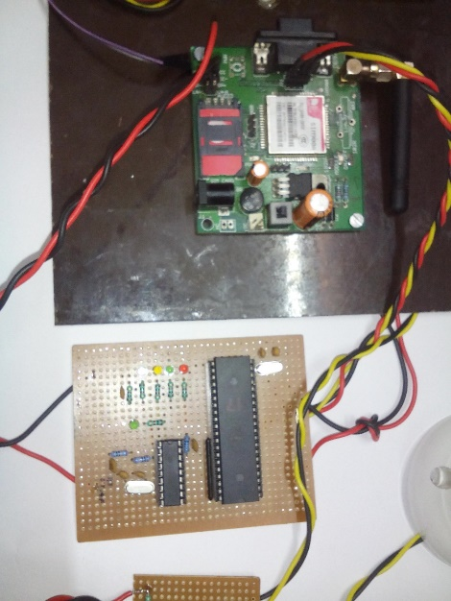
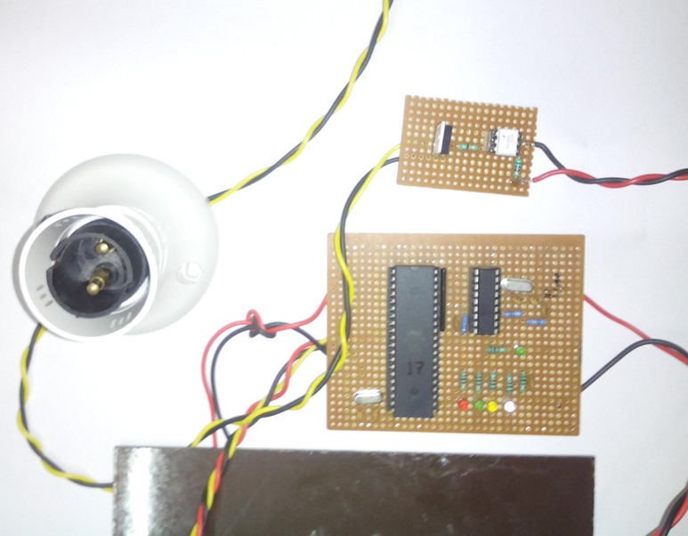
Hardware
Microcontroller
DIAC & TRIAC
GSM Board
DTMF Decoder
Bulb Holder

Slide 15
Other Applications
Industrial Appliances Controlling
Street Light Controlling
And Other AC appliances Controlling

Slide 16
Conclusion
By this project we have intended to reduce the complexities of modern life. As I have said earlier that By using our system one can check the status of the household appliances and operate them even from a remote location. This helps a person to keep his/her pace of life intact, in this fast moving world.

Slide 17
References
SIM900: http://probots.co.in/Manuals/SIM900%20GSM%20Modem%20- %20Starter%20Guide.pdf
SIM900 AT Commands Manual: www.propox.com/download/docs/SIM900_AT.pdf
89C51 Datasheet with Instruction Set: http://www.atmel.com/images/doc0313.pdf
DTMF Decoder: www.ece.usu.edu/ece_store/spec/HT9170.pdf
Optoisolator: kubuntu.free.fr/wiki/data/fp/moc3041.pdf
Triac: www.nxp.com/documents/data_sheet/BT136_SERIES.pdf

Slide 18
Thank you

